Slide 1
SWITCHING, ROUTING

Slide 2
Class 1: Basic Switch Configuration Using Packet Tracer
          What to Cover.
          Hostname (hostname sw1)
          Line Console Password (line console 0, password 1234, login)
          Line VTY password (line vty 0 15, password 1234, login)
          Enable Passwords (enable password 1234)
          Banner Messages (banner motd #This is sw1 for HR#)
          Logging Synchronous (line console 0, logging synchronous)
          Exec Timeout (line console 0, exec-timeout 4 0)
          Disable IP Domain Lookup(no ip domain lookup)
          Domain name (ip domain-name cisco.com)
          Username and password (username Admin password cisco)
          Encrypting all passwords (service password-encryption)
          Set current clock time and date (clock set 12:30:59 Feb 28 2023)
          Set management IP (int vlan 1, no shutdown, ip add 10.10.10.10 255.255.255.0)
          Configure default gateway (ip default-gateway 10.10.10.1)
          Save the Configuration (write/wr (privileged mode) or do write/wr(config mode))
          Show Saved and Running Configurations (show start/run(privileged mode) or do show start/run(config mode))

Slide 3
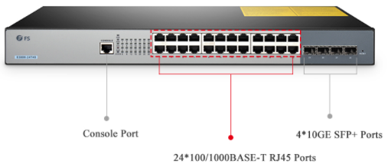
How to Connect PC to a Switch Using Console Cable | Other Switch Ports
What to Cover.
Types of Switch Ports
Port | Cabling | Function | Devices Connecting
Console Port | Console Cable | To configure the switch | Computers
Giga Port | CAT cable | To share data | Routers, switches, PCs
Ethernet Port | CAT cable | To share data | Routers, switches, PCs

Slide 4
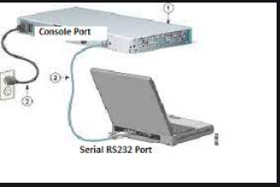
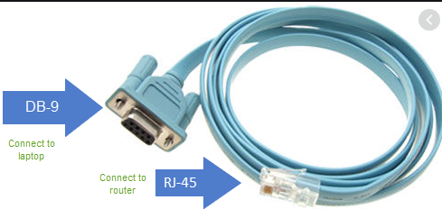
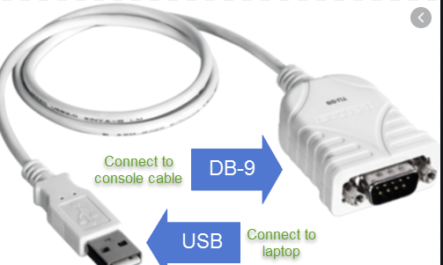
Connecting PC to Switch Using Console Cable.
Requirements
Hardware (PC, Switch and Console cable)
Software (Putty or Tera Term or Secure CRT)

Slide 5
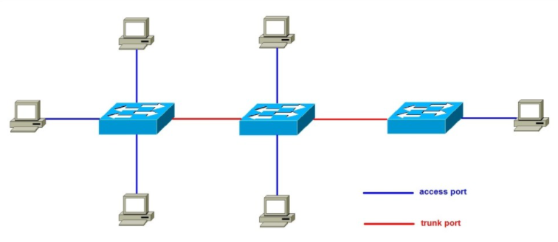
How to Configure Trunk and Access Switchport Modes
What to Cover.
Trunk and Access Switchport Modes
A switch port can be in one of two modes: access and trunk
Access Link- a port that can be assigned to a single VLAN. The frames that arrive on an access port are assumed to be part of the access VLAN.
Trunk port – a port that is connected to another switch. This port type can carry traffic of multiple VLANs, thus allowing you to extend VLANs across your entire network.
S1(config)# interface fastethernet0/1
S1(config-if)# switchport mode access
S1(config)# interface fastethernet0/2
S1(config-if)# switchport mode trunk

Slide 6
VLAN (Virtual Local Area Network)
A Virtual Local Area Network (VLAN) is a logical grouping of devices within a network, regardless of their physical location. VLANs are used to segment a larger network into smaller, isolated sub-networks, which helps improve network efficiency, security, and management.
Concepts of VLANs
Segmentation:
VLANs divide a single physical network into multiple logical networks. Each VLAN functions as a separate broadcast domain. This means devices in different VLANs do not see each other’s broadcasts unless a router or Layer 3 device facilitates communication between them.
Broadcast Domain:
Each VLAN creates its own broadcast domain. Devices within the same VLAN can communicate directly with each other, but devices in different VLANs must go through a router or Layer 3 switch to communicate.
VLAN Tagging:
VLANs are tagged using the IEEE 802.1Q standard. When a packet is sent over a trunk link between switches, a VLAN tag is added to the Ethernet frame header. This tag identifies which VLAN the frame belongs to. If the packet is sent over an access link, it does not carry a VLAN tag.

Slide 7
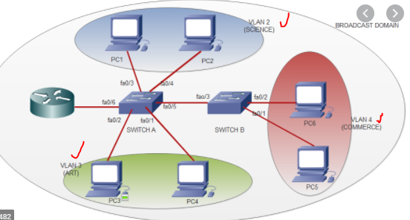
What is VLAN and How to Configure VLANs on a Switch
What to Cover.
What is VLAN (Virtual Local Area Network)
It is a way of creating multiple broadcast domains in a switch.
Then you logically group devices in the same broadcast domain.
Each VLAN acts as a subgroup of the switch ports in an Ethernet LAN.
A VLAN acts like a physical LAN, but it allows hosts to be grouped together in the same broadcast domain even if they are not connected to the same switch.
By default, all switchports are in VLAN 1
By default, devices in different VLAN won’t communicate.
Advantages of VLAN
Less costly.
Improves security.
Improves performance.
Separate LAN for each network.

Slide 8
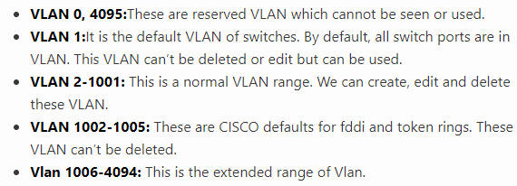
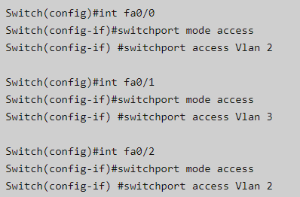
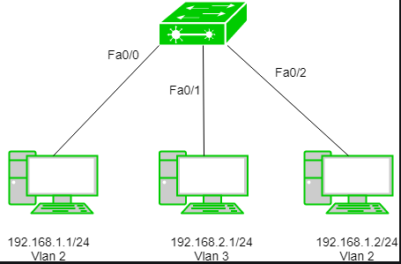
How to configure VLAN on a Switch

Slide 9
VLAN Configuration Expanded
How to Configure VLAN
Enable trunk to allow multiple VLANs
Test Communication
- Ping command e.g. ping 192.168.1.2
S1(config)# interface fastethernet0/2
S1(config-if)# switchport mode trunk

Slide 10
Basic Configuration
Basic Switch Configuration
These commands work on most Cisco-like CLI devices.
Initial Setup
Switch> enable
Switch# configure terminal
Switch(config)# hostname Switch1
Switch(config)# no ip domain-lookup
Switch(config)# service password-encryption
Switch(config)# enable secret 12345
Switch(config)#do write
Securing Access
Switch(config)# line console 0
Switch(config-line)# password MyConsolePass
Switch(config-line)# login
Switch(config-line)# exit
Switch(config)# line vty 0 4
Switch(config-line)# password MyVTYPass
Switch(config-line)# login
Management IP on Switch
Switch(config)# interface vlan 1
Switch(config-if)# ip address 192.168.1.2 255.255.255.0
Switch(config-if)# no shutdown
Switch(config)# ip default-gateway 192.168.1.1

Slide 11
SSH CONFIGURATION
Switch> enable
Switch# configure terminal
Switch(config)# hostname Switch1
Switch1(config)# ip domain-name example.com
Switch1(config)# username admin privilege 15 secret StrongPassword 123
Switch1(config)# crypto key generate rsa
Switch1(config)# ip ssh version 2
Switch1(config)# line vty 0 4
Switch1(config-line)# transport input ssh
Switch1(config-line)# login local
Switch1(config-line)# exit
Switch1# copy running-config startup-config / write
Telnet Configuration
Switch1(config)# line vty 0 4
Switch1(config-line)# transport input telnet
Switch1(config-line)# password TelnetPass123
Switch1(config-line)# login
Switch1(config-line)# exit

Slide 12
Advantages of VLANs
Improved Network Performance:
By isolating traffic, VLANs reduce broadcast traffic, thus improving overall network performance.
Enhanced Security:
VLANs help to segment traffic, making it more difficult for unauthorized users to access sensitive information. For instance, financial departments can be placed in a separate VLAN from general employees.
Simplified Management:
VLANs make it easier to manage a network by grouping users based on their function rather than their physical location. This makes changes such as adding new users or moving departments simpler.
Scalability:
VLANs can scale well, allowing a network to grow without causing broadcast storms or reducing performance.
Reduced Cost:
By allowing multiple logical networks to share the same physical infrastructure, VLANs reduce the need for separate physical networks, which lowers hardware costs.

Slide 13
SWITCH CONFIGURATION
# VLAN creation
Switch> enable
Switch# configure terminal
Switch(config)# vlan 10
Switch(config-vlan)# name VLAN10
Switch(config-vlan)# exit
Switch(config)# vlan 20
Switch(config-vlan)# name VLAN20
Switch(config-vlan)# exit
# Assign ports to VLANs
Switch(config)# interface range fastEthernet 0/1-10
Switch(config-if-range)# switchport mode access
Switch(config-if-range)# switchport access vlan 10
Switch(config-if-range)# exit
Switch(config)# interface range fastEthernet 0/11-20
Switch(config-if-range)# switchport mode access
Switch(config-if-range)# switchport access vlan 20
Switch(config-if-range)# exit
# Configure trunk to router
Switch(config)# interface gigabitEthernet 0/24
Switch(config-if)# switchport trunk encapsulation dot1q
Switch(config-if)# switchport mode trunk
Switch(config-if)# exit
# Save config
Switch# write memory

Slide 14
Router Configuration (Router-on-a-Stick)
Router> enable
Router# configure terminal
# Sub-interface for VLAN 10
Router(config)# interface gigabitEthernet 0/0.10
Router(config-subif)# encapsulation dot1Q 10
Router(config-subif)# ip address 192.168.10.1 255.255.255.0
Router(config-subif)# exit
# Sub-interface for VLAN 20
Router(config)# interface gigabitEthernet 0/0.20
Router(config-subif)# encapsulation dot1Q 20
Router(config-subif)# ip address 192.168.20.1 255.255.255.0
Router(config-subif)# exit
# Bring up the main interface
Router(config)# interface gigabitEthernet 0/0
Router(config-if)# no shutdown
Router(config-if)# exit
# Save config
Router# write memory

Slide 15

VLAN Trunking Protocol (VTP) Configuration
What to Cover.
What is VTP?
Makes it is possible to make configuration changes on one or more switches and have those changes automatically advertised to all the other switches in the same VTP domain. It’s cisco proprietary.
Automatically copies VLANs from one switch to another.
Hence, makes work easier since you just need to configure VLANs on one switch and automatically the configs are copied to other switches.
Some switches are configured as VTP servers and other switches are configured as VTP clients.
A VLAN created on a VTP server switch is automatically advertised to all switches inside the same VTP domain.
VTP Modes
VTP client mode – VTP client switch can’t change its VLAN configuration (cannot create or delete VLANs).But can process and forward vlans.
VTP server mode – VTP server switch mode can create and delete VLANs. This is the default mode for Cisco switches.
Transparent mode-

Slide 16
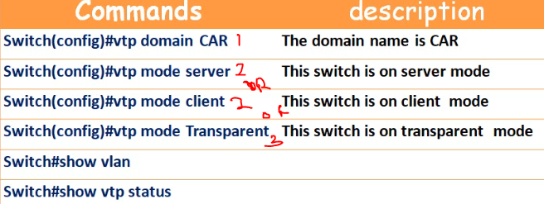
How to configure VTP on a Switch
Requirements
1. A switch has to be configured as either a VTP server or VTP client
2. The VTP domain name has to be the same on both switches
3. If present, the VTP domain password has to be the same
4. VTP versions have to match
5. The link between the switches has to be a trunk link

Slide 17
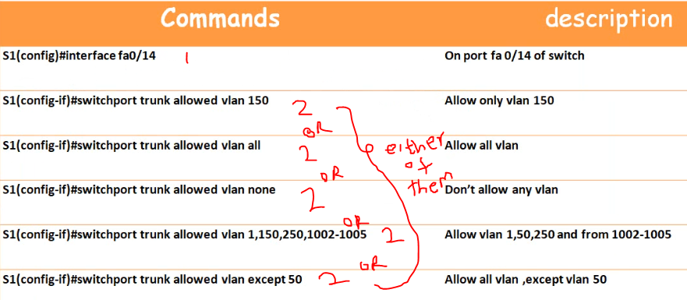
Class 5: Trunk Allowed/Denied VLANs Configuration
What to Cover.
This method allows or denies certain VLANs through the trunk interface.
Thus prevent some unnecessary traffic from being circulated across the network.
By default, all VLANs are allowed through the trunk interface.
How to Configure VLAN allowed/deny

Slide 18
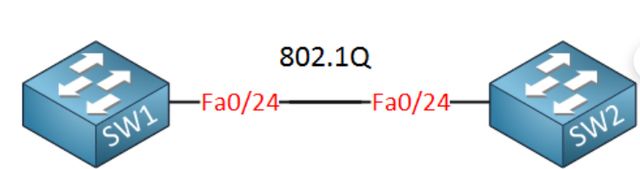
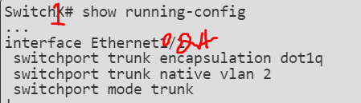
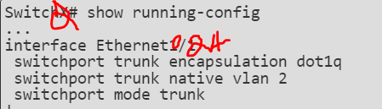
What to Cover.
What is Native VLAN?
In Default VLAN all switch ports turn into a member of the default VLAN 1
When frames traverse a Trunk port, a VLAN tag is added to distinguish which frames belong to which VLANs. Access ports do not require a VLAN tag, since all incoming and outgoing frames belong to a single VLAN. The Native VLAN is simply the one VLAN that traverses a Trunk port without a VLAN tag.
We configure trunk port with a Native VLAN, and whatever traffic arrives on that port without an existing VLAN tag, gets associated with your Native VLAN.

Slide 19
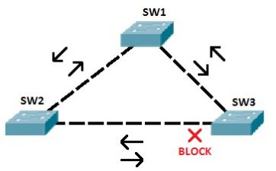
What is STP?
Spanning Tree Protocol (STP) is a network protocol designed to prevent layer 2 loops.
It is standardized as IEEE 802.1D protocol.
STP blocks some ports on switches with redundant links to prevent broadcast storms and ensure loop-free topology. With STP in place, you can have redundant links between switches in order to provide redundancy.
STP prevents loops by placing one of the switch ports in blocking state, which will be enabled whenever the other link is down.
In the topology above, STP has placed one port on SW3 in the blocking state. That port will no longer process any frames except the STP messages. If SW3 receives a broadcast frame from SW1, it will not forward it out the port connected to SW2.

Slide 20
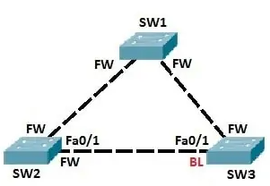
How STP Works
STP uses the Spanning-Tree Algorithm (SPA) to create a topology database of the network. To prevent loops, SPA places some interfaces in forwarding state and other interfaces in blocking state.
Conditions in STP
1. All switches in a network elect a root switch. All working interfaces on the root switch are placed in forwarding state.
2. All other switches, called nonroot switches, determine the best path to get to the root switch. The port used to reach the root switch (root port) is placed in forwarding state.
3. On the shared Ethernet segments, the switch with the best path to reach the root switch is placed in forwarding state. That switch is called the designated switch and its port is known as the designated port.
4. All other interfaces are placed in blocking state and will not forward frames.
Let’s say that SW1 is elected as the root switch. All ports on SW1 are placed into forwarding state. SW2 and SW3 choose ports with the lowest cost to reach the root switch to be the root ports. These ports are also placed in forwarding state. On the shared Ethernet segment between SW2 and SW3, port Fa0/1 on SW2 has the lowest cost to reach the root switch. This port is placed in forwarding state. To prevent loops, port Fa0/1 on SW3 is placed in blocking state.

Slide 21
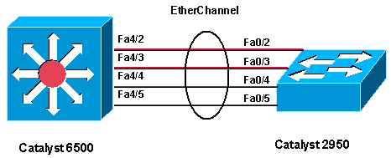
EtherChannel
Allows multiple physical Fast Ethernet links to combine into one logical channel. Maximum of 8 links can be aggregated to form a single logical link.
This allows load sharing of traffic among the links in the channel as well as redundancy in the event that one or more links in the channel fail.
No wastage of bandwidth, no loops, and there is redundancy.
Criteria To form an EtherChannel, all ports should have:
Same duplex
Same speed
Same VLAN configuration (i.e., native VLAN and allowed VLAN should be same)
Switch port modes should be same (access or trunk mode)

Slide 22
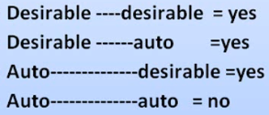
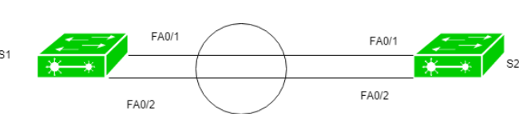
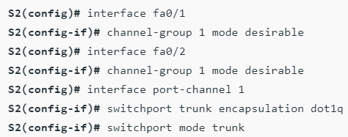
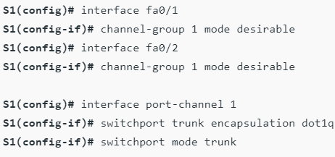
EtherChannel Protocols
PAgP and LACP
1. Port Aggregation Protocol (PAgP)
Port Aggregation Protocol is a Cisco proprietary protocol used to form an EtherChannel. There are different modes in which you can configure your interface. These are namely:
  ON: In this mode, the interface will be a part of EtherChannel but no negotiation takes place.
  Desirable: In this mode, the interface will continuously attempt to convert other side interface into an EtherChannel.
  Auto: In this mode, the interface will become a part of EtherChannel if and only of it is requested by the opposite interface.
  Off: No EtherChannel configured on the interface.
  How to Configure PAgP

Slide 23
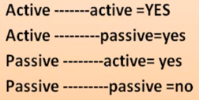
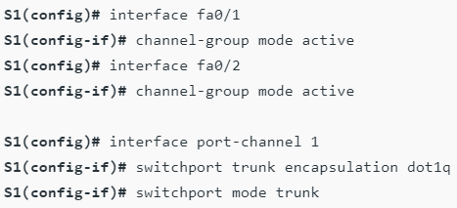
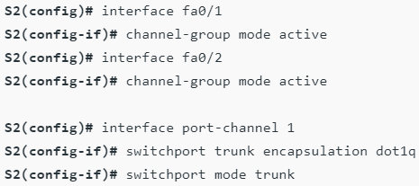
2. Link Aggregation Control Protocol (LACP)
Link Aggregation Control Protocol is an IEEE protocol, originally defined in 802.3ad, used to form an EtherChannel. This protocol is almost similar to Cisco PAgP. There are different modes in which you can configure your interface. These are namely:
  ON: In this mode, the interface will be a part of EtherChannel but no negotiation takes place
  Active: In this mode, the interface will continuously attempt to convert other side interface into an EtherChannel.
  Passive: In this mode, the interface will become a part of EtherChannel if and only of it is requested by the opposite interface.
  Off: No EtherChannel configured on the interface.
  How to Configure LACP

Slide 24
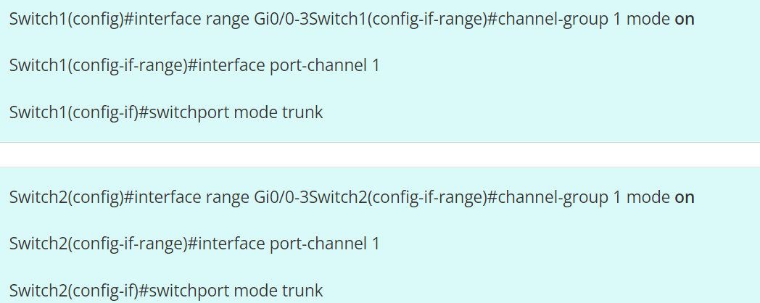
3. Manual EtherChannel Configuration Using ON Mode
When using an EtherChannel mode “ON”, EtherChannel will be created only when another interface group is in EtherChannel “on” mode.
The interface will be part of EtherChannel in this mode, without any negotiation protocol (LACP or PAGP).
There are different modes in which you can configure your interface. These are namely:
  ON: In this mode, the interface will be a part of EtherChannel but no negotiation takes place
  Off: No EtherChannel configured on the interface.
  How to Configure Manual EtherChannel

Slide 25
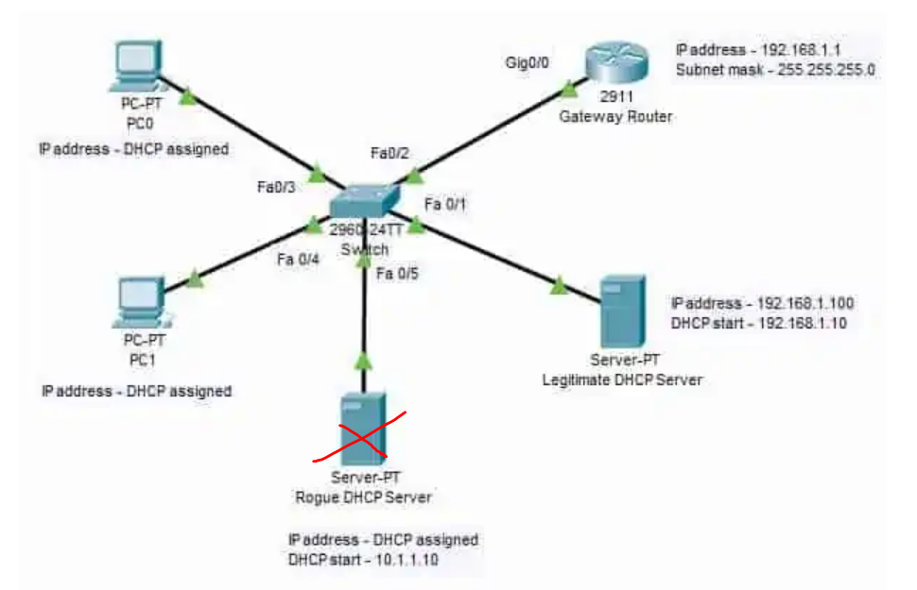
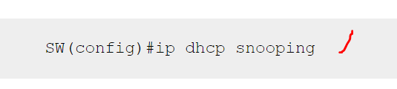
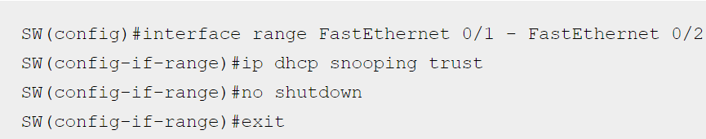

Class 10: DHCP Snooping Configuration
What to Cover.
DHCP Snooping is a security technology on a Layer 2 network switch that can prevent unauthorized DHCP servers from accessing your network.
It is a protection from untrusted hosts that want to become DHCP servers. DHCP Snooping works as a protection from man-in-the-middle attacks.
DHCP itself operates on Layer 3 of the OSI layer while DHCP snooping operates on Layer 2 devices to filter the traffic that is coming from DHCP clients.
To protect the host within the organization’s network to establish a connection from unauthorized rogue DHCP servers, we need to configure DHCP snooping on the Layer 2 switch where the unauthorized hosts are connected.
DCHP Snooping Trusted and Untrusted Ports
In Cisco switches, DHCP snooping is enabled manually. Trusted ports should be manually configured and the rest unconfigured ports are considered untrusted ports. Most devices connected to trusted ports are routers, switches, and servers. DHCP clients like PC and laptops are commonly connected to an untrusted port.

Slide 26
INTRODUCTION TO DHCP
DHCP stands for Dynamic Host Configuration Protocol. It’s a network management protocol used to automate the process of configuring devices on IP networks, allowing them to use network services like DNS, NTP, and more without manual setup.
Purpose of DHCP
Automatically assigns IP addresses to devices on a network.
Helps avoid IP conflicts by ensuring unique addresses are assigned to each device.
Reduces manual configuration errors and simplifies network management.

Slide 27
How DHCP Works
DHCP assigns IP addresses using a four-step process:
DHCP Discover - The client sends a broadcast message to locate a DHCP server.
DHCP Offer - The server responds with an IP address offer.
DHCP Request - The client requests the offered IP address.
DHCP Acknowledgment (ACK) - The server confirms the IP lease.
Components of DHCP
DHCP Server - The device or software providing IP addresses.
DHCP Client - Any device (computer, phone, printer) that requests an IP address.
IP Lease - The duration a client can use an IP address before it expires.

Slide 28
DHCP Packet Structure and Operation
DHCP Packet Fields
Each DHCP packet contains fields essential to address assignment, such as:
Client IP Address - The IP assigned to the client. what the client already has
Your IP Address - Assigned IP for the client by the server. what the server offers
Server IP Address - The IP address of the DHCP server. the DHCP server’s IP
Gateway IP Address - Typically, the network's default gateway. the relay/gateway in between
Types of DHCP Messages
Discover: Sent by the client to locate DHCP servers.
Offer: The server’s offer of an IP address to the client.
Request: The client’s request to accept an IP address.
Acknowledge (ACK): Server’s confirmation message.

Slide 29
DHCP Operation Steps
Client Initialization: The client connects to the network and initiates a DHCP Discover message.
Server Response: The server responds with an Offer.
Lease Acquisition: The client sends a Request to accept the lease.
Lease Acknowledgment: The server sends an ACK, finalizing the process.

Slide 30
DHCP Configuration
Define DHCP Pool
Router(config)# ip dhcp pool POOL_NAME
Creates a DHCP pool with the specified name.
Router(dhcp-config)# network NETWORK_ADDRESS SUBNET_MASK Defines the IP range and subnet for the pool.
Define Default Gateways
Router(dhcp-config)# default-router DEFAULT_GATEWAY
Specifies the gateway clients should use.
Set DNS Server
Router(dhcp-config)# dns-server DNS_IP
Exclude IP Addresses (Optional)
Router(config)# ip dhcp excluded-address START_IP END_IPExcludes
IPs from the DHCP pool.
lease <days> <hours> <minutes>

Slide 31
Cisco Layer 3 Switch DHCP Server
! Create VLAN interfaces
interface vlan 10
ip address 192.168.10.1 255.255.255.0
no shutdown
interface vlan 20
ip address 192.168.20.1 255.255.255.0
no shutdown
! DHCP pools
ip dhcp pool VLAN10-POOL
network 192.168.10.0 255.255.255.0
default-router 192.168.10.1
dns-server 8.8.8.8
ip dhcp pool VLAN20-POOL
network 192.168.20.0 255.255.255.0
default-router 192.168.20.1
dns-server 8.8.8.8
! Optional: exclude static addresses
ip dhcp excluded-address 192.168.10.1 192.168.10.20
ip dhcp excluded-address 192.168.20.1 192.168.20.20

Slide 32
Network Address Translation (NAT)

Slide 33
Network Address Translation (NAT)
is a method used by routers to modify the source or destination IP address of packets as they pass through the router.
NAT allows multiple devices on a local network (using private IP addresses) to share a single public IP address for accessing the internet.
This process is vital because there are limited public IP addresses available globally, and NAT helps mitigate IP address exhaustion by using private IP addresses within local networks.
Why NAT is Important:
Conserves Public IP Addresses: NAT allows multiple devices on a local network to access the internet using a single public IP address.
This reduces the need for a public IP for each device, which is especially important given the shortage of IPv4 addresses.
Security: NAT adds a layer of security by masking internal private IP addresses. External devices on the internet cannot directly communicate with devices behind a NAT unless specific rules (such as port forwarding) are set up.

Slide 34
Types of NAT:
There are three common types of NAT used in networking:
Static NAT (One-to-One Mapping):Static NAT maps one private IP address to one public IP address.
This is used when a specific internal device (like a web server) needs to be accessible from the internet using a consistent public IP.
Use Case: Hosting a public-facing server on a private network.
Example:
Private IP: 192.168.1.10
Public IP: 203.0.113.5
The router always maps 192.168.1.10 to 203.0.113.5
2. Dynamic NAT (Many-to-Many Mapping): Dynamic NAT assigns public IP addresses from a pool of available public IPs to private IP addresses on a local network. This mapping is temporary and changes over time. When a device inside the network makes a request, it gets mapped to an available public IP from the pool.
Useful when you have more than one public IP and multiple devices needing internet access.
Example: Private IPs: 192.168.1.10, 192.168.1.11 and Public IP Pool: 203.0.113.5, 203.0.113.6
Each private IP is dynamically mapped to a public IP from the pool.

Slide 35
3. PAT (Port Address Translation) or :Overloading
PAT is the most common form of NAT.
It allows multiple devices on a private network to share a single public IP address by differentiating traffic using port numbers.
Each device is mapped to the same public IP but with a different port number.
Most home and office networks use PAT because it allows multiple devices to share one public IP address.
Example:
Private IP: 192.168.1.10 → Public IP: 203.0.113.5:10001
Private IP: 192.168.1.11 → Public IP: 203.0.113.5:10002
Here, both devices are using the same public IP but with different port numbers (10001, 10002).

Slide 36
How NAT Works (PAT Example)
Device makes a request: A device with a private IP address (192.168.1.10) makes a request to a web server on the internet.
NAT modifies the packet: The router changes the source IP address from 192.168.1.10 to its public IP address (203.0.113.5), and also assigns a port number (e.g., 203.0.113.5:10001).
Router forwards the request: The router sends the request to the web server.
Response returns: The web server responds to the public IP address and port (203.0.113.5:10001).
NAT reverses the translation: When the router receives the response, it looks up its NAT table to see which private IP corresponds to the port number. It then forwards the response back to the internal device (192.168.1.10).
NAT Example in Action
Consider a home network where three devices (PC, phone, and tablet) are using private IPs (e.g., 192.168.1.2, 192.168.1.3, 192.168.1.4) behind a router with a single public IP (203.0.113.5).
When each device connects to the internet, NAT on the router maps their private IPs to the public IP but assigns different port numbers to differentiate the sessions.
PC (192.168.1.2) → Public IP (203.0.113.5:10001)
Phone (192.168.1.3) → Public IP (203.0.113.5:10002)
Tablet (192.168.1.4) → Public IP (203.0.113.5:10003)

Slide 37
Advantages of NAT
IP Address Conservation: NAT allows the use of fewer public IPs by sharing one public IP address among many internal devices.
Security: NAT hides the internal network structure, as external devices only see the public IP. This adds a layer of security by not exposing the private IP addresses of individual devices.
Network Flexibility: NAT allows private IP addresses to be reused in different networks without conflict, helping with IPv4 address exhaustion.
Disadvantages of NAT
Complicates Peer-to-Peer Communication: NAT can make direct communication between two devices (such as in VoIP or online gaming) more complex because both devices are hidden behind their respective NAT routers.
Latency: NAT introduces additional processing, which can introduce a small delay in packet transmission.
NAT Traversal Issues: Certain applications, especially those requiring direct connections (like VPNs, peer-to-peer applications), may face issues when working across NAT, requiring additional configurations like port forwarding or UPnP.

Slide 38
NAT CONFIGURATIONS
a single private IP is mapped to a single public IP address. This is often used for services like web or mail servers that need to be accessible from the internet.
Router(config)# interface GigabitEthernet0/0
Router(config-if)# ip address 192.168.1.1 255.255.255.0
Router(config-if)# exit
Router(config)# interface GigabitEthernet0/1
Router(config-if)# ip address 203.0.113.2 255.255.255.0
Router(config-if)# exit
# Create the Static NAT mapping
Router(config)# ip nat inside source static 192.168.1.10 203.0.113.5
# Specify which interfaces are inside (LAN) and outside (WAN)
Router(config)# interface GigabitEthernet0/0
Router(config-if)# ip nat inside
Router(config-if)# exit
Router(config)# interface GigabitEthernet0/1
Router(config-if)# ip nat outside
Router(config-if)# exit
In this configuration: Private IP 192.168.1.10 is mapped to the public IP 203.0.113.5.
Devices outside the network can access the internal device at 192.168.1.10 using 203.0.113.5

Slide 39
Static NAT maps a single internal (private) IP address to a single external (public) IP address. This is commonly used for servers that need a consistent public IP.
Example
Inside Local (Private IP): 192.168.1.10Inside
Global (Public IP): 203.0.113.10
interface GigabitEthernet0/0
ip address 192.168.1.1 255.255.255.0
ip nat inside
interface GigabitEthernet0/1
ip address 203.0.113.1 255.255.255.0
ip nat outside
ip nat inside source static 192.168.1.10 203.0.113.10
ip nat inside source static 192.168.1.10 203.0.113.10: Maps the internal IP 192.168.1.10 to the external IP 203.0.113.10.
Traffic from 192.168.1.10 going outside will be seen as 203.0.113.10, and incoming traffic to 203.0.113.10 will be directed to 192.168.1.10.

Slide 40
Dynamic NAT maps a pool of internal (private) IP addresses to a pool of external (public) IP addresses. T
his is used when multiple devices need access to the Internet but don’t need a consistent IP address.
Example
Inside Network: 192.168.1.0/24 Public IP Pool: 203.0.113.10 to 203.0.113.20
interface GigabitEthernet0/0
ip address 192.168.1.1 255.255.255.0
ip nat inside
interface GigabitEthernet0/1
ip address 203.0.113.1 255.255.255.0
ip nat outside
ip nat pool PUBLIC_POOL 203.0.113.10 203.0.113.20 netmask 255.255.255.0
ip nat inside source list 1 pool PUBLIC_POOL
access-list 1 permit 192.168.1.0 0.0.0.255
ip nat pool PUBLIC_POOL 203.0.113.10 203.0.113.20 netmask 255.255.255.0:
Defines a pool of public IP addresses.
ip nat inside source list 1 pool
PUBLIC_POOL: Maps the access list to the public IP pool for NAT translation.
access-list 1 permit 192.168.1.0 0.0.0.255:
Allows IP addresses in the 192.168.1.0/24 subnet to be translated.

Slide 41
PAT (Port Address Translation)PAT allows multiple internal IP addresses to share a single external IP address by using different port numbers.
This is commonly used when there are limited public IPs available.
Example
Inside Network: 192.168.1.0/24
Single Public IP: 203.0.113.10
interface GigabitEthernet0/0
ip address 192.168.1.1 255.255.255.0
ip nat inside
interface interface GigabitEthernet0/1
ip address 203.0.113.10 255.255.255.0
ip nat outside
ip nat inside source list 1 interface GigabitEthernet0/1 overload
access-list 1 permit 192.168.1.0 0.0.0.255
ip nat inside source list 1 interface GigabitEthernet0/1 overload:
Enables PAT, allowing multiple devices in the 192.168.1.0/24 network to share the IP address 203.0.113.10 by overloading different port numbers.
access-list 1 permit 192.168.1.0 0.0.0.255: Permits IP addresses in the 192.168.1.0/24 subnet for translation.

Slide 42
3. PAT (Port Address Translation) or :Overloading
PAT is the most common form of NAT.
It allows multiple devices on a private network to share a single public IP address by differentiating traffic using port numbers.
Each device is mapped to the same public IP but with a different port number.
Most home and office networks use PAT because it allows multiple devices to share one public IP address.
Example:
Private IP: 192.168.1.10 → Public IP: 203.0.113.5:10001
Private IP: 192.168.1.11 → Public IP: 203.0.113.5:10002
Here, both devices are using the same public IP but with different port numbers (10001, 10002).

Slide 43
Access Control Lists (ACLs)

Slide 44
An Access Control List (ACL)
is a set of rules used on a router or firewall to filter network traffic. It acts like a firewall by either permitting or denying packets based on criteria such as source and destination IP addresses, port numbers, or protocol types (e.g., TCP, UDP, ICMP).
Key Functions of an ACL
Traffic Filtering: The primary role is to control which packets are allowed to pass through an interface.
Security: ACLs are a fundamental layer of network security, used to block unwanted traffic, prevent unauthorized access to specific network segments, and mitigate certain types of attacks.
Traffic Management: They can be used to classify traffic for Quality of Service (QoS), to control access for Network Address Translation (NAT), or to trigger other network services.

Slide 45
How ACLs Work
Rule-based Processing: An ACL is a sequence of permit or deny statements (rules). The device processes packets against these rules from top to bottom.
First Match Wins: The device stops processing the list as soon as it finds a matching rule. It executes the action (permit or deny) and ignores any subsequent rules.
Implicit Deny: Every ACL, by default, has an implicit deny-all statement at the end. This means if a packet does not match any rule in the list, it will be denied. This is a critical security feature.

Slide 46
Types of ACLs
Standard ACLs:
  Filter traffic based only on the source IP address.
  Use numbers 1-99 and 1300-1999.
  Because they are less specific, they should be placed as close to the destination as possible to prevent them from filtering too much traffic unnecessarily.
Extended ACLs:
  Filter traffic based on a wider range of criteria, including source IP address, destination IP address, protocol type (TCP/UDP), and port numbers.
  Use numbers 100-199 and 2000-2699.
  Because they are more specific, they should be placed as close to the source as possible to block unwanted traffic before it consumes network resources.

Slide 47
ACL Naming
ACLs can be numbered (as above) or named. Named ACLs are generally preferred because they are easier to read, manage, and debug. For example, ip access-list extended BLOCK_WEB_TRAFFIC.
Configuration and Best Practices
Placement is Key:
  Extended ACLs: Place them near the source.
  Standard ACLs: Place them near the destination.
Comments: Use comments to explain the purpose of each rule. This makes the ACL much easier to understand and maintain.
Implicit Deny: Always remember the implicit deny at the end. If you want to allow any other traffic, you must add an explicit permit any statement at the end of your list.
Order of Rules: Be careful with the order of rules. More specific rules should be placed before more general rules. For example, a deny statement for a single host should come before a permit statement for the entire subnet.
One ACL per Interface per Direction: You can apply only one ACL per interface for each direction (inbound or outbound). For example, interface FastEthernet0/0 can have one inbound ACL and one outbound ACL.

Slide 48
Block 192.168.1.50 — everything else allowed
access-list 5 deny 192.168.1.50 0.0.0.0
access-list 5 permit any
interface fa0/0
ip access-group 5 in
❗Important Remember
Standard ACL only checks source IP.
If no "deny" lines are added, everything else is implicitly denied.
Direction:
in = traffic coming into the router
out = traffic leaving the router

Slide 49
Ex:
Block Facebook using ACL (via DNS IPs)
Step 1: Find Facebook IP addresses
For example, suppose DNS lookup gives:
157.240.0.0/16 (Facebook IP range)
We will deny traffic to that range.

Slide 50
Step 2: Configure Extended ACL on the router
Router> enable
Router# configure terminal
! Create extended ACL
Router(config)# access-list 110 deny ip any 157.240.0.0 0.0.255.255
Router(config)# access-list 110 permit ip any any
! Apply ACL to outgoing interface (towards the internet)
Router(config)# interface GigabitEthernet0/1
Router(config-if)# ip access-group 110 out
Router(config-if)# exit
✅ This blocks all internal users from going to any server in 157.240.0.0/16
✅ All other traffic is permitted

